Slide 1


1
          GUI PROGRAMMING USING TKINTER
By Shaily Jain

Slide 2
Introduction
3
TK is an open source toolkit used to develop Graphical user Interface.
It provides a library of interactive widgets which are GUI elements and commonly used in desktop applications .
It has things like Buttons , Menus ,Windows and test entry fields.
In Early 90’ s Tk was developed as an extension for Tool Command Language (Tcl).

Slide 3
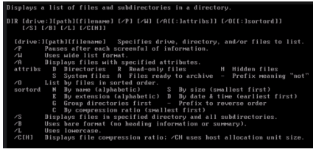
There are 2 methods for the interaction of computer with the user that is CUI and GUI
• Character user interaction is noting but interaction with the text
• An example of CUI is as follows

Slide 4
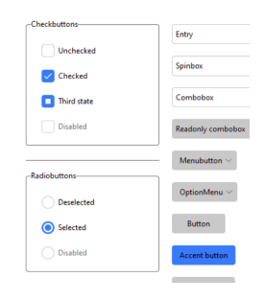
The latest devices and computer that we are using all have GUI that is graphical user interface, an example of GUI are

Slide 5
Introduction to GUI Programming
7
Before going to the examples, we will give you a brief introduction to GUI application development. This will provide you with some of the general background you need to move forward.
Setting up a GUI application is similar to how an artist produces a painting. Conventionally, there is a single canvas onto which the artist must put all the work. Here’s how it works:
you start with a clean slate, a “top-level” windowing object on which you build the rest of your components.

Slide 6
Python
Tkinter Module
-tkinter (c)
Tk Widgets(C and Tcl)
Tk(C)
Xlib(C)

Slide 7
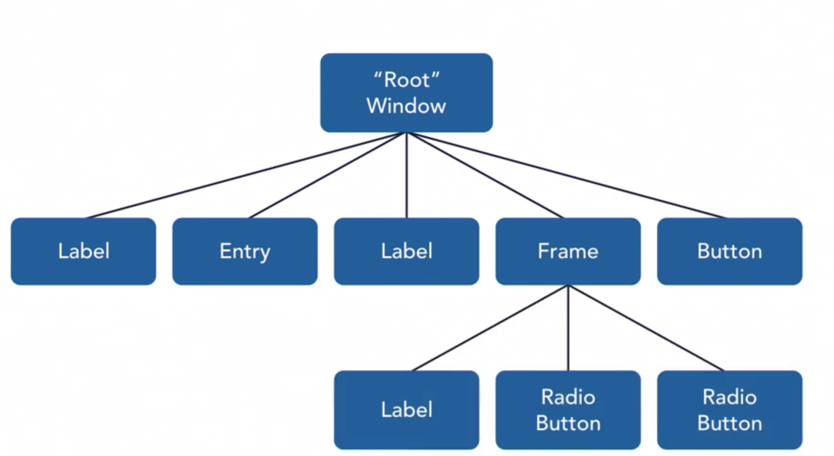
The hierarchy of Tk Widgets
Parent widget
When you create a new widget object , you have to specify parent widget . You can make Hierarchy as deep as you want . Example :-You can add controls inside the frame .

Slide 8
First Application

Slide 9
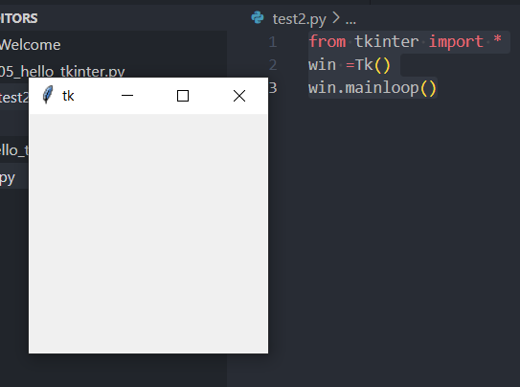
In just three line of code you can create a GUI application.

Slide 10
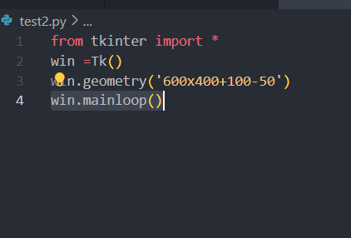
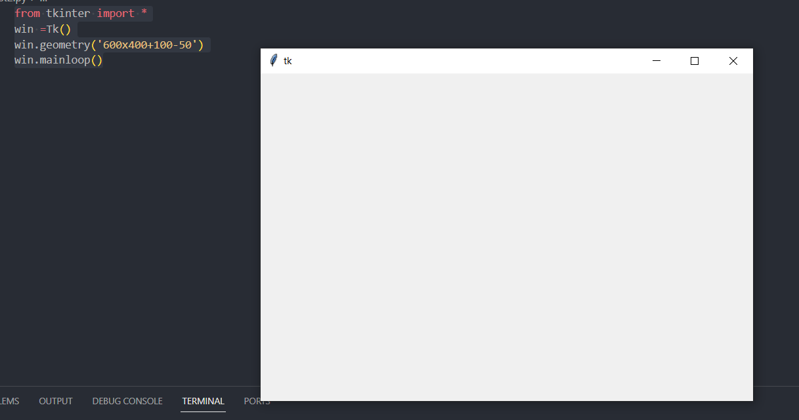
To set the size and width of the window we can use the .geometry( ),
We can set the height, width also we can locate the window on the screen at specific point by providing the x , y co-ordinate
• For instance,

Slide 11
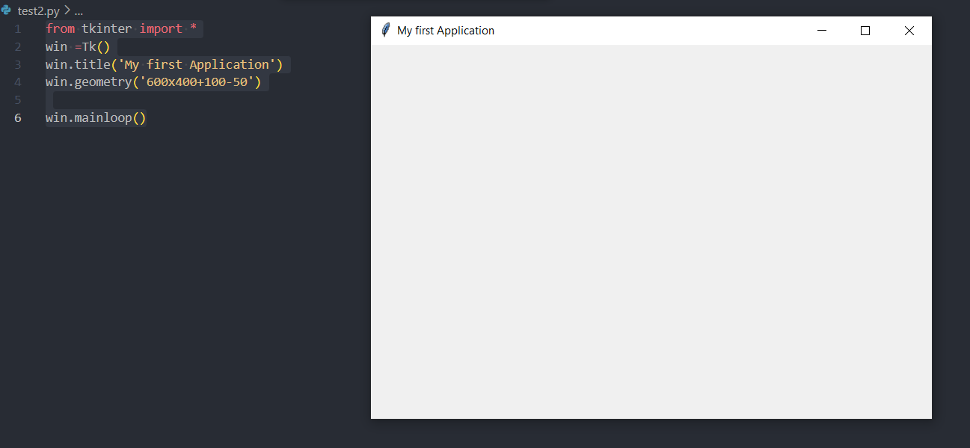
from tkinter import *
win =Tk()
win.title('My first Application')
win.geometry('600x400+100-50')
win.mainloop()

Slide 12
Resizing the window is also quite simple in tkinter. , for instance if we do not want the window to resize on x- axis we can simply give its value as FALSE as given below
from tkinter import *
win = Tk()
win.title('My first Application')
win.geometry('600x400+100-50')
win.resizable(False,True)
win.mainloop()

Slide 13
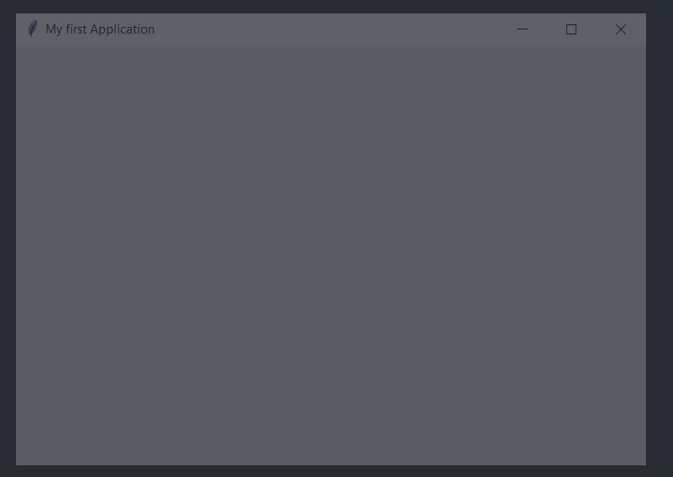
In attribute the method alpha is use to give opaqueness to the window
from tkinter import *
win = Tk()
win.title('My first Application')
win.geometry('600x400+100-50')
win.resizable(False,True)
win.attributes('-alpha', 0.25)
win.mainloop()

Slide 14
What is Widgets?

Slide 15
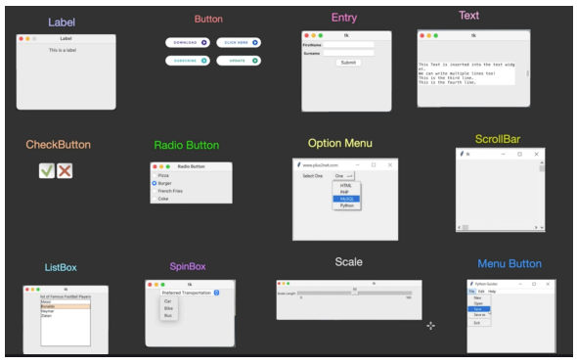
Some of the widgets that are supported by tkinter are as follows

Slide 16
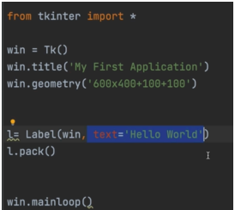
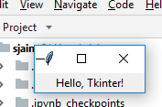
Hello World Example with lable
from tkinter import *
root = Tk()
Label(root, text="Hello, Tkinter!").pack()
root.mainloop()
Step 1:- Module tkinter imported
Step 2:- Main Parent Root declared with main module
Step 3
Step 4
Step 5
Out put

Slide 17
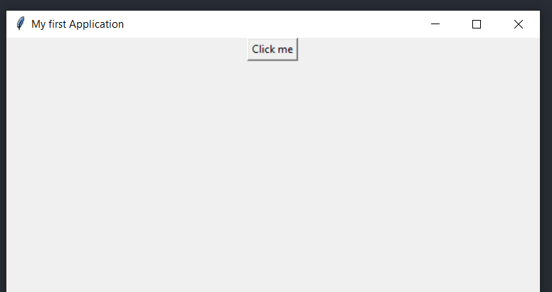
We can create a button simply by using the following statement , although the button created dose not perform any action as it is not connected to any event function
from tkinter import *
win = Tk()
win.title('My first Application')
win.geometry('600x400+100-50')
b = Button(win, text='Click me')
b.pack()
win.mainloop()

Slide 18

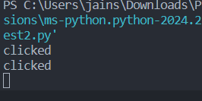
Callbacks
A callback is the name of the function that is to be run in response of an event
Callbacks can be defined as a free standing function in our program or as a class member.
from tkinter import *
win = Tk()
win.title('My first Application')
win.geometry('600x400+100-50')
def callback():
print ("clicked")
b = Button(win, text='Click me', command=callback)
b.pack()
win.mainloop()

Slide 19
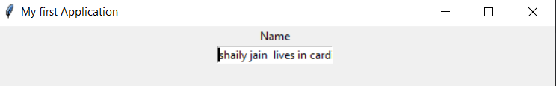
The entry widget have a text box in which the user can give the input depending upon the requirement
from tkinter import *
win = Tk()
win.title('My first Application')
win.geometry('600x400+100-50')
l = Label(win, text='Name')
l.pack()
e = Entry(win)
e.pack()
win.mainloop()

Slide 20
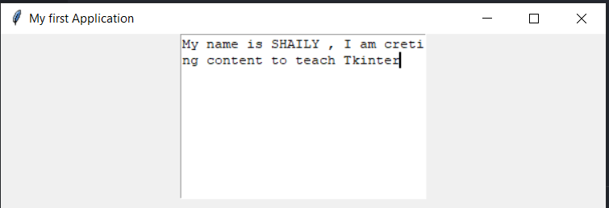
The text area allows you to have multiple line of text where as the entry allows you to have only 1 line of text
from tkinter import *
win = Tk()
win.title('My first Application')
win.geometry('600x400+100-50')
t = Text(win, width= 30 , height= 10)
t.pack()
win.mainloop()

Slide 21
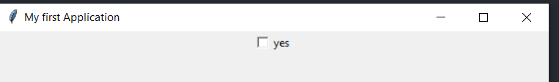
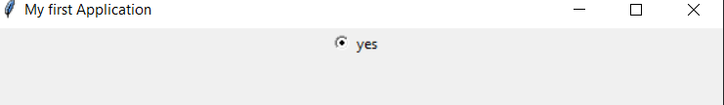
The creation of check button and radio button is similar, instead of the name radio button we can write check button and its functionality will change to it
from tkinter import *
win = Tk()
win.title('My first Application')
win.geometry('600x400+100-50')
c = Radiobutton(win, text ='yes')
c.pack()
win.mainloop()

Slide 22
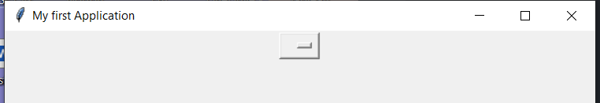
• The option menu is is nothing but a menu having collection of multiple options and we can select one from it, creating it is quite simple and easy
from tkinter import *
win = Tk()
win.title('My first Application')
win.geometry('600x400+100-50')
o = OptionMenu(win,'python', 'var', 'java', 'c++', 'python')
o.pack()
win.mainloop()

Slide 23
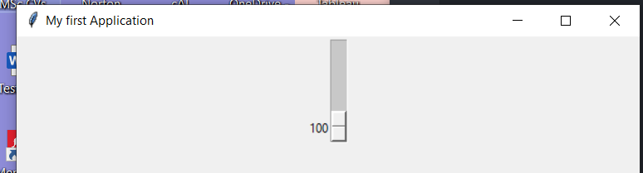
Likewise creating scale is also easy process
from tkinter import *
win = Tk()
win.title('My first Application')
win.geometry('600x400+100-50')
s = Scale(win, from_ = 0, to=100)
s.pack()
win.mainloop()

Slide 24
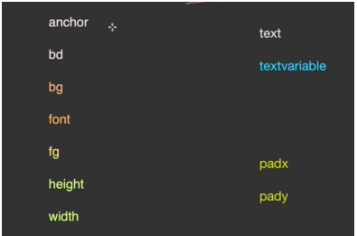
Widget Options
Some common widget properties are

Slide 25

Here some options are applicable to some widgets only however most of them works on all widget here
• For ex : text option works on label, button, check button, radio button
Like wise the bg options work on most of the widgets
from tkinter import *
win = Tk()
win.title('My first Application')
win.geometry('600x400+100-50')
l= Label(win, text='hello world', bg= 'red')
l.pack()
win.mainloop()
You can try Radio Button , Button as well instead of label as bg and text are options with widgets

Slide 26
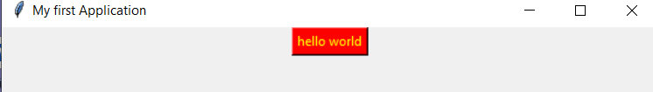
from tkinter import *
win = Tk()
win.title('My first Application')
win.geometry('600x400+100-50')
l= Button(win)
l['text'] = 'hello world'
l[ 'bg'] = 'red'
l[ 'fg'] ='yellow'
l.pack()
win.mainloop()
Here I have used fg , bg and text option with button

Slide 27
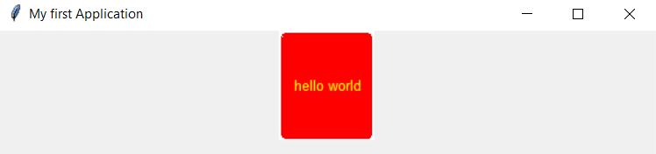
from tkinter import *
from tkmacosx import *
win = Tk()
win.title('My first Application')
win.geometry('600x400+100-50')
l= Button(win)
l['text'] = 'hello world'
l[ 'bg'] = 'red'
l[ 'fg'] ='yellow'
l.pack()
l.configure(font='Ariel, 10', height =100)
win.mainloop()
Pip install tkmacosc
View
Terminal
cd..
add
Careful about spacing in tkinter

Slide 28
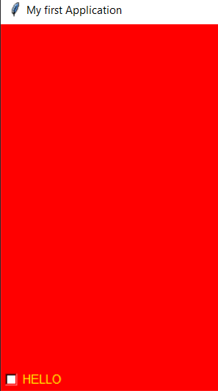
The options which work on specific widgets and are important are as anchor, bd, height, width, textvariable, padx, pady
For ex : height and width works perfectly for label and button but it doesn’t work on check and radio button .Anchor will allow you to anchor the text on any 1 position of the control or widget
from tkinter import *
from tkmacosx import *
win = Tk()
win.title('My first Application')
win.geometry('600x400+100-50')
l= Checkbutton(win, text='HELLO', width=100 ,height=100)
l['anchor'] ='sw'
l[ 'bg'] = 'red'
l[ 'fg'] ='yellow'
l.configure(font='Ariel, 10', height =100)
l.pack()
win.mainloop()

Slide 29
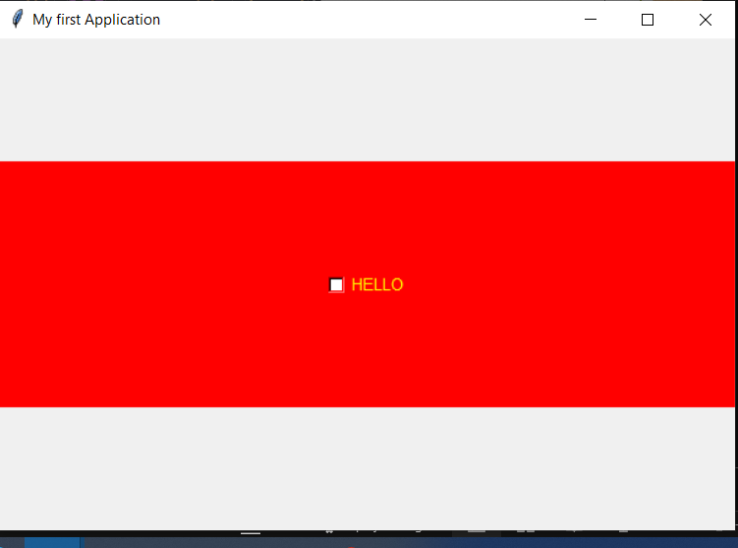
from tkinter import *
from tkmacosx import *
win = Tk()
win.title('My first Application')
win.geometry('600x400+100-50')
l= Checkbutton(win, text='HELLO', width=100, variable='var')
l['justify'] ='right'
l[ 'bg'] = 'red'
l[ 'fg'] ='yellow'
l[ 'bd'] =3
l.configure(font='Ariel, 10', height =100)
l.pack(pady=100)
win.mainloop()
• Bd is the border depth of the widget
• padx and pady are the padding given to the widget
• The text or data that is available on the window is taken inside the variable option

Slide 30
Advance Widget Options

Slide 31
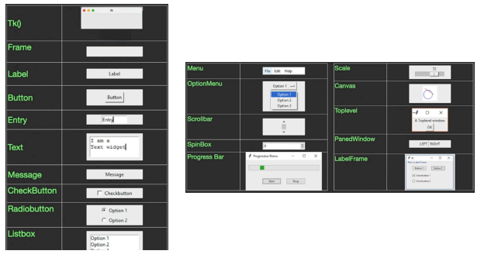
The various widgets that are available in tkinter are as follow
https://tkdocs.com/shipman/

Slide 32
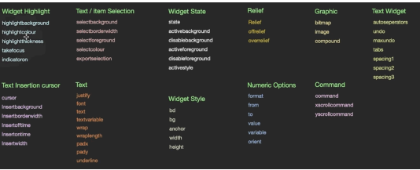
The common widgets properties are, these are available on most of the widgets but to all

Slide 33
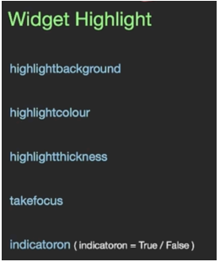
Widget Option : state
Highlight is use to make something standout from others which is currently being used
• This is also called as focus
• The highlight options are as follows

Slide 34
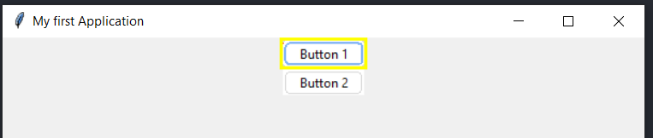
from tkinter import *
from tkmacosx import *
win = Tk()
win.title('My first Application')
win.geometry('600x400')
b1 = Button(win, text='Button 1', highlightbackground='red', highlightthickness=3, highlightcolor='yellow')
b1.pack()
b2 = Button(win, text='Button 2')
b2.pack()
win.mainloop()
Try using Entry widget instead of button , remove text as Entry does not support text option.
b2 = Button(win, text='Button 2’, tekefocus=0)
see what happen?

Slide 35
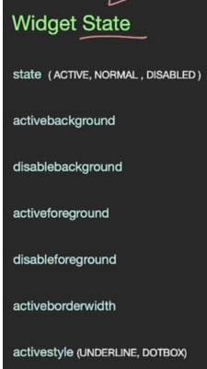
Widget state has 3 options ACTIVE, NORMAL , DISABLED

Slide 36
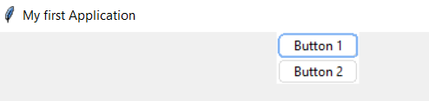
from tkinter import *
from tkmacosx import *
win = Tk()
win.title('My first Application')
win.geometry('600x400')
b1 = Button(win, text='Button 1', state=NORMAL)
b1.pack()
b2 = Button(win, text='Button 2')
b2.pack()
win.mainloop()
Normal state is very common by default

Slide 37
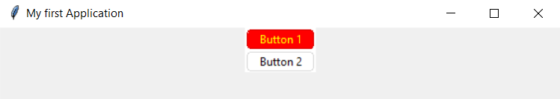
The other state options are
from tkinter import *
from tkmacosx import *
win = Tk()
win.title('My first Application')
win.geometry('600x400')
b1 = Button(win, text='Button 1', state=DISABLED, disabledbackground='red', disabledforeground='yellow')
b1.pack()
b2 = Button(win, text='Button 2')
b2.pack()
win.mainloop()

Slide 38
On previous slide now try Active state
Then try Entry widget
Remember Entry does not support text option.
Tell me what you notice what is the difference?

Slide 39
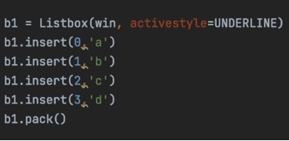
We can also change the active style of the state in a widge :- Try it out

Slide 40
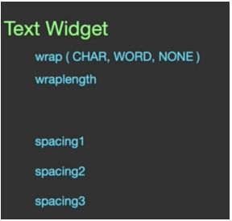
Widget Option : Text Wrap
Wrap means when we type in multiline text and reach the end of line the cursor moves to the next line and our remaining text continue in the next line this process of continuation from next line to the other is called text wrapping.
The wrapping can be done by character wise, word wise or NONE , the default Is character.

Slide 41
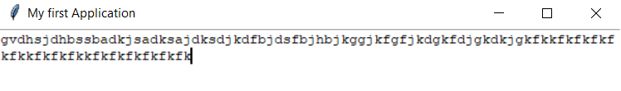
from tkinter import *
#from tkmacosx import *
#from tkinter.font import *
win = Tk()
win.title('My first Application')
win.geometry('600x400')
t1 = Text(win, wrap=WORD)
t1.pack()
win.mainloop()
Characterise Wrapping is by default try None as well
Also try Spacing1= 100
Spacing2= 100
Spacing 3=100

Slide 42
When we give spacing1 = 100, there is a gap of 100 px given in the beginning then the text starts appearing
When we give spacing2 = 100, there is a gap of 100px given in between two line in the widget
When we give spacing3 = 100, there is a gap of 100px at the bottom of the widget, but it will best work with scroll bar.

Slide 43
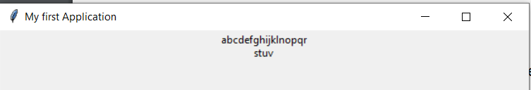
The other option is wraplength, this works only with one widget Label widget
• This means after a given length the text should be wrapped to the next line
from tkinter import *
#from tkmacosx import *
#from tkinter.font import *
win = Tk()
win.title('My first Application')
win.geometry('600x400')
l1 = Label(win, text='abcdefghijklnopqrstuv', width=100, wraplength=100)
l1.pack()
win.mainloop()

Slide 44
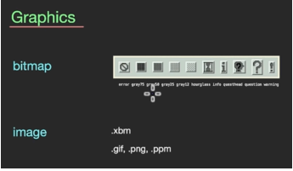
Widget Options : Graphic
This is useful for various widgets
• The options available for these are

Slide 45

from tkinter import *
#from tkmacosx import *
#from tkinter.font import *
win = Tk()
win.title('My first Application')
win.geometry('600x400')
l1 = Checkbutton(win, text='Label 1', bitmap='hourglass')
l1.pack()
win.mainloop()

Slide 46
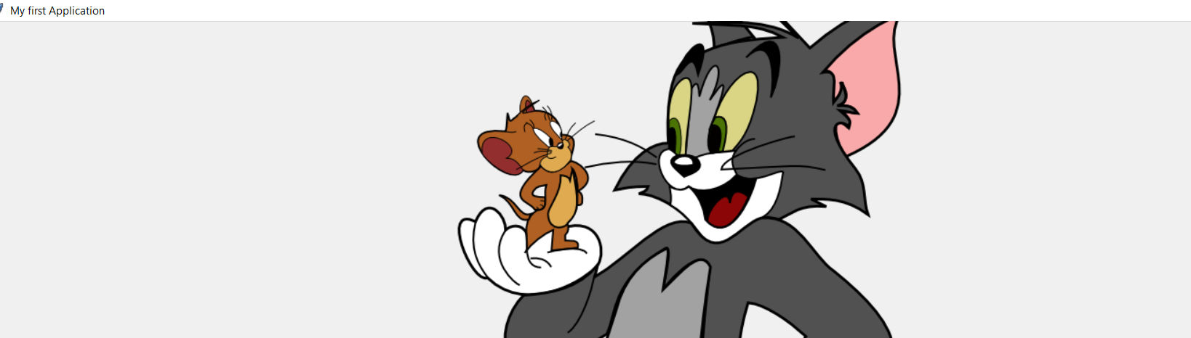
from tkinter import *
#from tkmacosx import *
#from tkinter.font import *
win = Tk()
win.title('My first Application')
win.geometry('700x500')
img = PhotoImage(file ='cat.png')
l1 = Checkbutton(win, text='Label 1', image=img)
l1.pack()
win.mainloop()

Slide 47
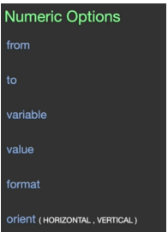
Widget Options : Number

Slide 48
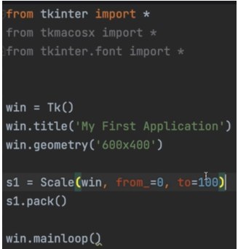
from and to gives the range of values for a widget (scale and spinbox)

Slide 49

Scale is having an option called variable which is not available for the spin box
• The variable option is basically a default which we set for a widget, it is just like text variable
• The value option is available for various type of variable such as Intvar( ), Stringvar( ) using this we can set the default value of a variable
• The format option is only available for spin box only

Slide 50

Orient is nothing but the orientation that means if there is a horizontal scrollbar you can make it a vertical one

Slide 51
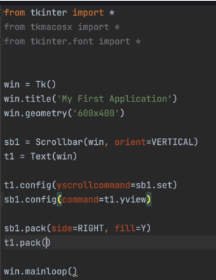
The scrollbar works along with other widgets such as text, Entry, list widget etc
• Even if the scrollbar is positioned properly in the widget it will not work until we connect the scrollbar to the required widget through xscrollcommand or yscrollcommand.

Slide 52
Following are few more examples but first get hand of everything:_

Slide 53

Button Widget Demo
Buttons can contain text or images, and you can associate a Python function or method with each button. When the button is pressed, tkinter automatically calls that function or method.
The button can only display text in a single font, but the text may span more than one line. In addition, one of the characters can be underlined, for example to mark a keyboard shortcut. By default, the Tab key can be used to move to a button widget.
from tkinter import *
top = Tk()
quit = Button(top, text='Hello World!', command=top.quit)
quit.pack()
mainloop()

Slide 54
import tkinter as tk
button_flag = True
def click():
"respond to the button click"
global button_flag
# toggle button colors as a test
if button_flag:
button1.config(bg="white")
button_flag = False
else:
button1.config(bg="green")
button_flag = True
root = tk.Tk()
Button Image Demo

Slide 55
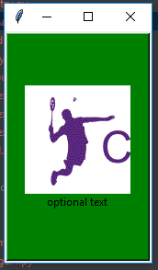
frame1 = tk.Frame(root)
frame1.pack(side=tk.TOP, fill=tk.X)
# create a frame and pack it
#frame1 = tk.Frame(root)
#frame1.pack(side=tk.TOP, fill=tk.X)
photo1 = tk.PhotoImage(file="badminton.gif")
# pick a (small) image file you have in the working directory ...
# photo1 = tk.PhotoImage(file="rpi.gif")
# create the image button, image is above (top) the optional text
button1 = tk.Button(frame1, compound=tk.TOP, width=148, height=240, image=photo1,text="optional text", bg="green", command=click)
button1.pack(side=tk.LEFT, padx=2, pady=2)
# save the button's image from garbage collection (needed?)
button1.image = photo1
# start the event loop
root.mainloop()
Now create a image related to your project name. Choose one selected image (Decision on only one image ).

Slide 56

Label and Button Demo
import tkinter as tk
top = tk.Tk()
hello = tk.Label(top, text='Hello World!')
hello.pack()
quit = tk.Button(top, text='QUIT', command=top.quit, bg='red', fg='white')
quit.pack(fill=tk.X, expand=1)
tk.mainloop()
You can use the fill=X and expand options
to make a widget as wide as the parent widget, even if the user resizes the window.

Slide 57
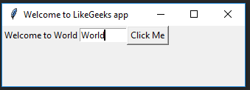
Text Entry
• used to enter or display a single line of text
• To enter multiple lines of text, use the Text widget.
from tkinter import *
window = Tk()
window.title("Welcome to LikeGeeks app")
window.geometry('350x200')
lbl = Label(window, text="Hello")
lbl.grid(column=0, row=0)
txt = Entry(window,width=10)
txt.grid(column=1, row=0)
def clicked():
res = "Welcome to " + txt.get()
lbl.configure(text= res)
btn = Button(window, text="Click Me", command=clicked)
btn.grid(column=2, row=0)
window.mainloop()

Slide 58
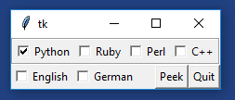
Checkbuttons and Radiobuttons
Check buttons are used for multiple choice situations, i.e. choosing m of n possible options. This is done by assigning each checkbox a variable of its own.
Radio buttions are used for choosing one of n possible choices; i.e. a mutually exclusive single choice by giving each button a unique value of the same tkinter variable.
Lets see how to make a Gui with a Choice option , best to create multiple choice question .

Slide 59
from tkinter import *
class Checkbar(Frame):
def __init__(self, parent=None, picks=[], side=LEFT, anchor=W):
Frame.__init__(self, parent)
self.vars = []
for pick in picks:
var = IntVar()
chk = Checkbutton(self, text=pick, variable=var)
chk.pack(side=side, anchor=anchor, expand=YES)
self.vars.append(var)
def state(self):
return map((lambda var: var.get()), self.vars)
if __name__ == '__main__':
root = Tk()
lng = Checkbar(root, ['Python', 'Ruby', 'Perl', 'C++'])
tgl = Checkbar(root, ['English','German'])
lng.pack(side=TOP, fill=X)
tgl.pack(side=LEFT)
lng.config(relief=GROOVE, bd=2)
def allstates():
print(list(lng.state()), list(tgl.state()))
Button(root, text='Quit', command=root.quit).pack(side=RIGHT)
Button(root, text='Peek', command=allstates).pack(side=RIGHT)
root.mainloop()

Slide 60

Radio Button
from tkinter import *
from tkinter.ttk import *
window = Tk()
window.title("Welcome to LikeGeeks app")
selected = IntVar()
rad1 = Radiobutton(window,text='First', value=1, variable=selected)
rad2 = Radiobutton(window,text='Second', value=2, variable=selected)
rad3 = Radiobutton(window,text='Third', value=3, variable=selected)
def clicked():
print(selected.get())
btn = Button(window, text="Click Me", command=clicked)
rad1.grid(column=0, row=0)
rad2.grid(column=1, row=0)
rad3.grid(column=2, row=0)
btn.grid(column=3, row=0)
window.mainloop()

Slide 61
Now Create a Gui Interface for your department ,
.

